Slide 1
Deadlines & Resources
Thank you for taking part in Ignite NZ 2015
Below is a list of key dates and resources:
Important Content Deadlines –detailed instructions are found on the Speaker Portal:
August 2 by 11:59pm: Upload a DRAFT of your PPT for Track Owner review.
August 28 by 11:59pm: Upload FINAL PPT presentation on the Speaker Portal. Continue to rehearse your spoken presentation but do not make any more edits to the deck. The uploaded version will be available on the PCs at the venue.
YOUR PROMPT FINAL PPT SUBMISSION IS APPRECIATED. No design support will be offered onsite at the conference.
Slide Design Resources – Located on the Speaker Portal (graphics, webinar, etc.)
If you include any third-party photography or art, licensing information and permission must be credited in the PPT or it may be deleted.
Points of Contact
Direct presentation questions to your track owner.
PRINTING: This template is intentionally set to print in color or grayscale, not black and white.

Slide 2
Scrub Checklist
Upload your final deck on the speaker portal on or before August 28, 2015 at 11:59pm NZST.
PowerPoint presentations undergo a brief scrub process and are posted online for delegates to access after the conference.
The Scrub Process will include:
Verification that required slides are included
Remove any non-template logos and graphics from the walk-in slide
Remove all comments, hidden slides and speaker notes from slides
Set file properties box
Reset printability to grayscale
Notify Presentation Manager of any images identified as unlicensed for escalation
Rename files to match naming convention
Correct session title and session code to match printed Mini Guide and Schedule Builder
Speakers, you must:
Use the provided event template and associated colors, fonts, layout and transition slides
Correct product names to follow applicable branding rules

Slide 4
101 ways to authenticate with Azure Active Directory
Rory Braybrook
M338

Slide 6
For cloud authentication, Azure Active Directory has you covered

Slide 7
Overview
Protocols
Use cases
OWIN
ADAL
WIF
Access Panel
SaaS

Slide 8
Won’t be covering
DirSync
AADSync
AD Connect
MFA
AAD Proxy

Slide 9
Azure AD by the Numbers
86%
of Fortune 500 companies on Microsoft Cloud (Azure, O365, CRM Online and PowerBI)
Azure AD manages identity data for
>5 M organizations
More than
500 M objects hosted on Azure Active Directory
1 Trillion
Azure AD authentications since the release of the service
50 M Office 365 users active every month
>1 Billion authentications every day on Azure AD
Every Office 365 and Microsoft Azure customer uses Azure Active directory

Slide 10
The Protocols

Slide 11
Protocols
WS Federation
SAML-P 2.0
OAuth2
OpenID Connect

Slide 12
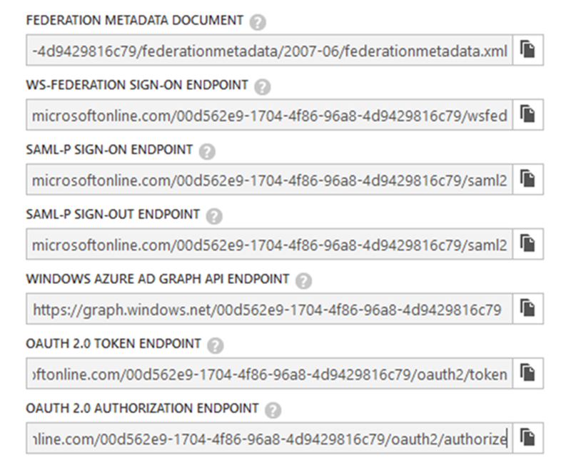

Slide 15
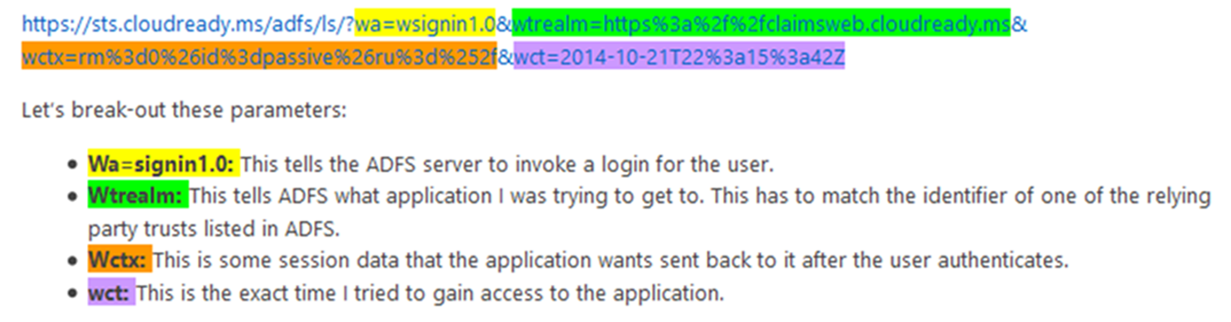
WS Federation
http://blogs.technet.com/b/askpfeplat/

Slide 16
WS Federation
http://blogs.technet.com/b/askpfeplat/

Slide 17
WS Federation
http://blogs.technet.com/b/askpfeplat/

Slide 18
WS Federation
http://blogs.technet.com/b/askpfeplat/

Slide 19
WS Federation
http://blogs.technet.com/b/askpfeplat/

Slide 20
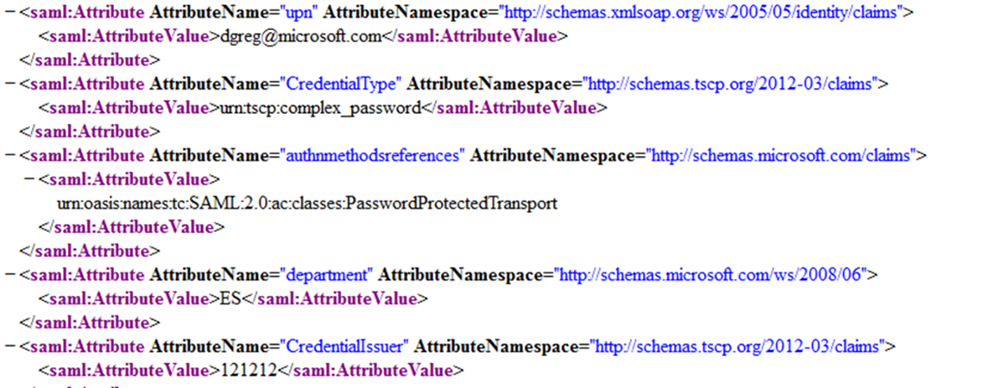
SAML token attributes

Slide 21
SAML token attributes

Slide 22
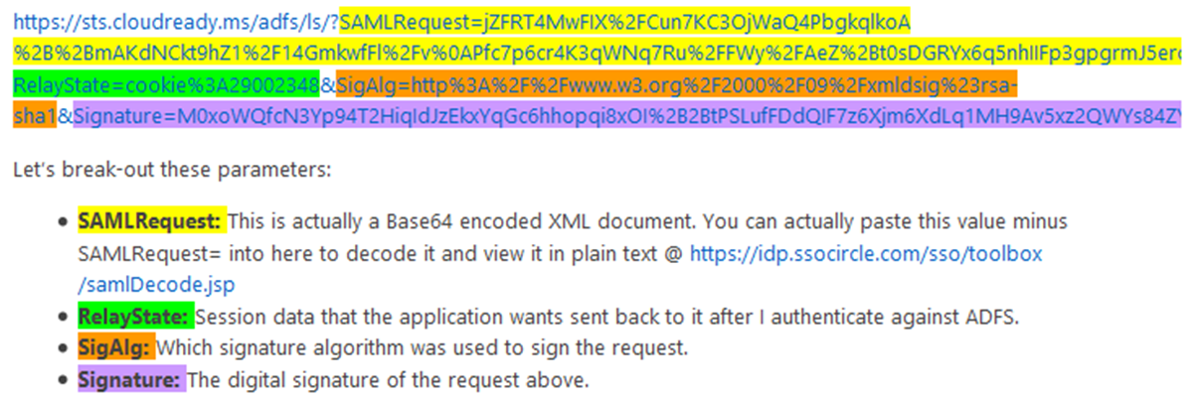
SAML-P
http://blogs.technet.com/b/askpfeplat/

Slide 23
SAML-P
http://blogs.technet.com/b/askpfeplat/

Slide 24
SAML-P
http://blogs.technet.com/b/askpfeplat/

Slide 25
SAML-P
http://blogs.technet.com/b/askpfeplat/

Slide 26
SAML-P
http://blogs.technet.com/b/askpfeplat/

Slide 27
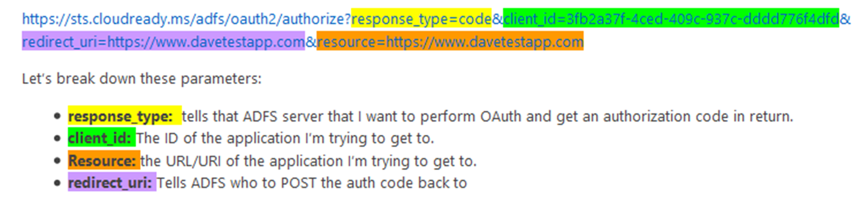
OAuth2
http://blogs.technet.com/b/askpfeplat/

Slide 28
OAuth2
http://blogs.technet.com/b/askpfeplat/

Slide 29
OAuth2
http://blogs.technet.com/b/askpfeplat/

Slide 30
OAuth2
http://blogs.technet.com/b/askpfeplat/

Slide 31
OAuth2
http://blogs.technet.com/b/askpfeplat/

Slide 32




Manipulate AAD using API
Use OAuth endpoint to get token
AAD
Use token in REST call to endpoint
Token issued
Notes:
RB

Slide 33
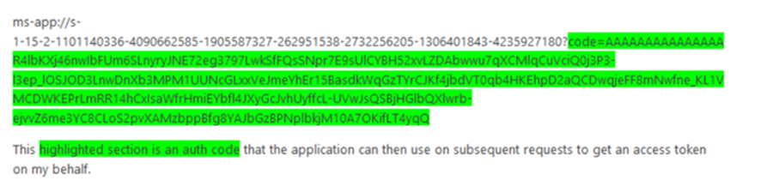
OAuth2
http://blogs.technet.com/b/askpfeplat/

Slide 34
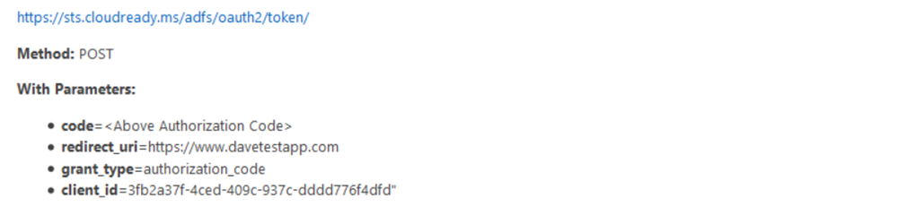
OAuth2
http://blogs.technet.com/b/askpfeplat/

Slide 35
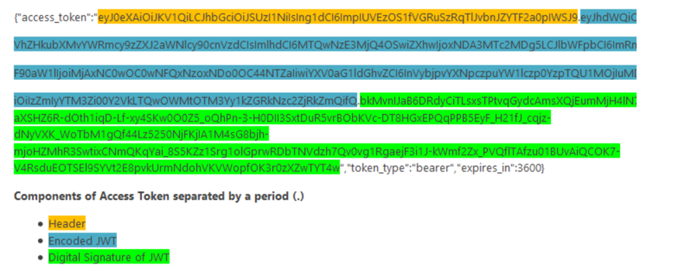
OAuth2
http://blogs.technet.com/b/askpfeplat/

Slide 36
OAuth2 token
Access token
ID token (OpenID Connect)
Refresh token
http://blogs.technet.com/b/askpfeplat/

Slide 37
Use cases

Slide 38



Authentication scenarios
Browser
Web application
Web API
js
Native app
Web API
Web API
Server app
Clients using wide variety of devices/languages/platforms
Server applications using wide variety of platforms/languages
video.ch9.ms/teched/2012/na/SIA209.pptx

Slide 39
Authentication scenarios
WS-Fed, SAML 2.0, OpenID Connect
Web application
OAuth 2.0
Web API
Browser
js
Native app
OAuth 2.0
OAuth 2.0
Web API
Web API
Server app
OAuth 2.0
OAuth 2.0
Standard-based, http-based protocols for maximum platform reach
video.ch9.ms/teched/2012/na/SIA209.pptx

Slide 40
VS “Change Authentication”

Slide 41
Demo - Lap around VS “Change Authentication”

Slide 42
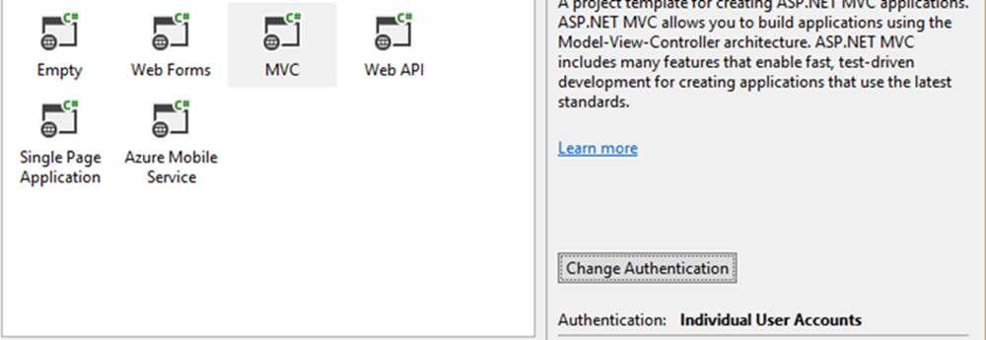
Change authentication

Slide 43
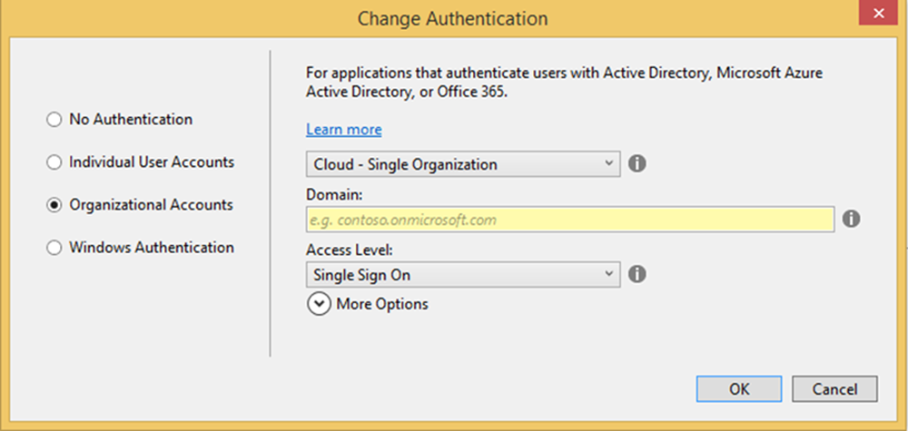
Change authentication

Slide 44
Wrappers around the protocols
OWIN
(All)
WIF
(WS Federation)
ADAL
(OpenID Connect / OAuth)

Slide 45
Demo - Lap around AAD Applications

Slide 46
OWIN OpenID Connect
app.SetDefaultSignInAsAuthenticationType(CookieAuthenticationDefaults.AuthenticationType);
app.UseCookieAuthentication(new CookieAuthenticationOptions());
app.UseOpenIdConnectAuthentication(
new OpenIdConnectAuthenticationOptions
{
ClientId = clientId,
Authority = authority,
PostLogoutRedirectUri = postLogoutRedirectUri,
Notifications = new OpenIdConnectAuthenticationNotifications()
{
….
}

Slide 47
Demo - OWIN – OpenID Connect / WS Federation

Slide 48
Demo - OWIN – WS Federation

Slide 49
Demo – WIF - WS Federation

Slide 50
Open Web Interface for .NET (OWIN) (Identity) vs Windows Identity Foundation (WIF)

Slide 51
OWIN
Supported with new protocols being added
WS Fed / OpenID Connect / OAuth2 / SAML-P (Community)
Invoked via code
Easy to do with VS 2013/15
JWT token
Microsoft.OWIN
WIF
Supported
WS Fed / SAML-P CTP (deprecated)
ASP.NET pipeline
Have to “retro-fit” from template or use VS 2010/12
XML token
System.IdentityModel

Slide 52
OWIN ID
Supported with new protocols being added
WS Fed / OpenID Connect / OAuth2 / SAML-P (Community)
Invoked via code
Easy to do with VS 2013/15
JWT token
Microsoft.OWIN
WIF
Supported
WS Fed / SAML-P CTP (deprecated)
ASP.NET pipeline
Have to “retro-fit” from template or use VS 2010/12
XML token
System.IdentityModel

Slide 53
Active Directory Authentication Library (ADAL)

Slide 54
ADAL Mission statement
The Active Directory Authentication Library (ADAL) is a library meant to help developers to take advantage of Azure Active Directory for enabling client applications to access protected resources

Slide 55
SDK available on multiple platforms
.NET, iOS, JavaScript, Android, Node.JS, Java, Windows Store, Windows Phone etc.
Caching and automatic refresh token
Asynchronous support
Basis of Graph API and Azure Management Library
Now open source

Slide 56
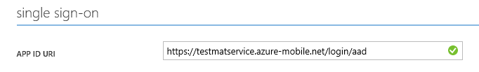
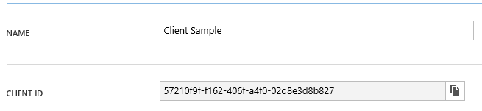
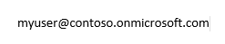
Active Directory Authentication Library
string clientId = "[Enter client ID as obtained from Azure Portal]";
string authority = "https://login.windows.net/[your tenant name]";
string myURI = "[Enter App ID URI of your service]";
AuthenticationContext authContext = new AuthenticationContext(authority);
AuthenticationResult result = await authContext.AcquireTokenAsync(myURI, clientId);
Notes:
RB

Slide 57
Active Directory Authentication Library
string clientId = "[Enter client ID as obtained from Azure Portal]";
string authority = "https://login.windows.net/[your tenant name]";
string myURI = "[Enter App ID URI of your service]";
AuthenticationContext authContext = new AuthenticationContext(authority);
AuthenticationResult result = await authContext.AcquireTokenAsync(myURI, clientId);

Slide 58
Demo – Graph API via ADAL with Groups

Slide 59
Social

Slide 60
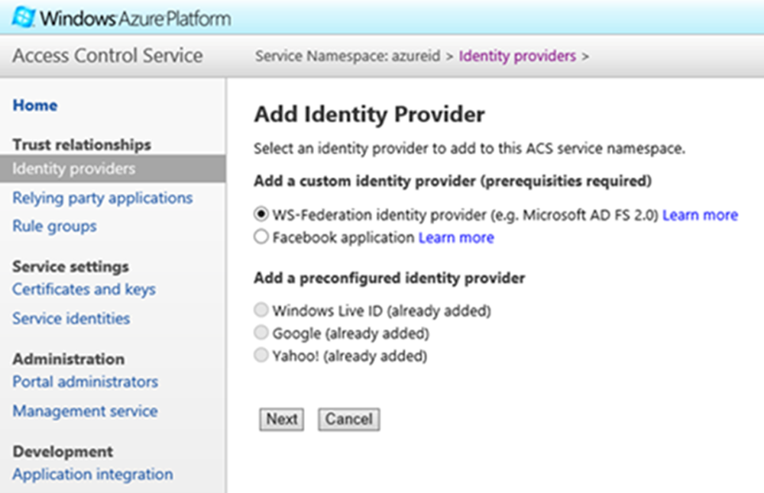
ACS

Slide 61
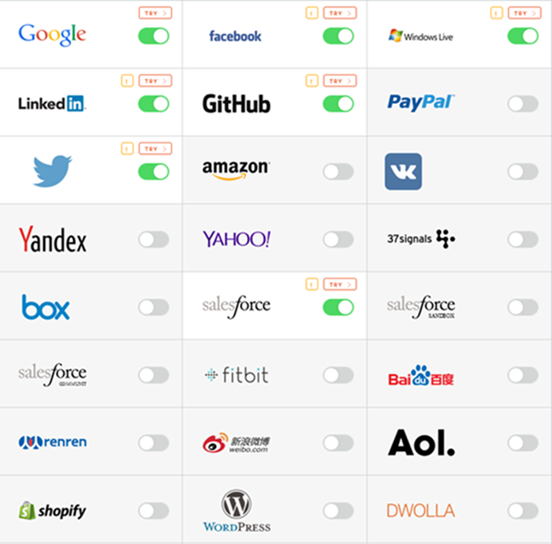
IaaS

Slide 62
Azure AD as an IDP

Slide 63
Can federate with 3rd party application in Gallery e.g. SalesForce
AAD as an IDP
Can federate with e.g. ADFS via metadata
Can use user name and password via the Access Panel e.g. Twitter
Can federate with 3rd party application not in Gallery via the Access Panel / Custom / SAML-P

Slide 64
Demo – Azure AD WS Federation

Slide 65
Application
ADFS
WS Fed
AAD

Slide 66
Demo – Lap around AAD external applications and the Access Panel

Slide 67
Demo – AAD SAML-P 2.0 Federation

Slide 68
ADFS
AAD Access Panel
SAML-P
Application

Slide 69
Azure AD Passport.js

Slide 70
passport-azure-ad is a collection of Passport strategies to help you integrate with Azure Active Directory
Includes OpenID Connect, WS-Federation, and SAML-P authentication and authorization
Lets you integrate your Node app with Microsoft Azure AD so you can use web single sign-on (WebSSO), Endpoint Protection with OAuth, and JWT token issuance and validation

Slide 71
Converged Microsoft Account and AAD Programming Model

Slide 72
Converged Microsoft Account and Azure Active Directory Programming Model
In preview
Sign-in to both personal and work users with a single button
Consolidated sign-in page:
Under the covers, figures out if the username corresponds to a personal account or a work account
New app model - https://apps.dev.microsoft.com

Slide 73
Windows 10

Slide 74
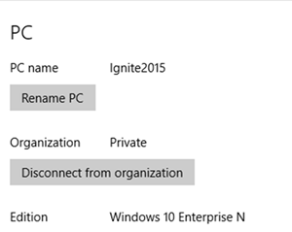
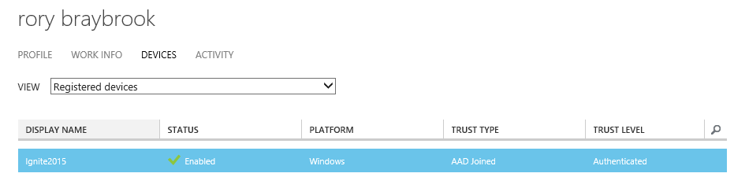
Windows 10 AD Join

Slide 77
Presentation fonts/typography
What are the font choices and sizes?
Any font size 28pt or larger should use Segoe UI Light
Any type that is less than 28pt should use Segoe UI
On one slide, try to use a maximum of 3 font sizes
Where to start
Control focus by using scale versus bullets
Use color to draw focus when necessary
Start with main topic at 40pt and subtopics at 20pt
Title/sentence casing and periods
Title text should be “sentence case”
All supporting slide text should be sentence case except for names and products

Slide 78
Preferred text layout (no bullets)
Main topic 1: size 40pt
Size 20pt for the subtopics
Size 20pt for the subtopics
Main topic 2: size 40pt
Size 20pt for the subtopics
Size 20pt for the subtopics
Main topic 3: size 40pt
Size 20pt for the subtopics
Size 20pt for the subtopics

Slide 79
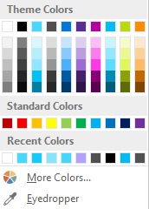
Slide palette info
The PowerPoint palette for this template has been built for you and is shown below. Avoid using too many colors in your presentation.
Select the 4th color from the left for subheads and 1st level non-bulleted text color, or wherever “color” text is preferred over the default black/white text
Accent colors 1-6 – (6 Theme Colors to the far right)
Text
Light 2
Accent 1
Accent 2
Accent 3
Accent 4
Accent 5
Accent 6
Use Accent 1 as the main accent color. Use Accent 2 and Accent 3 when additional colors are needed.
Use Accents 4-6 sparingly – only when more colors are necessary

Slide 80
Chart Example

Slide 88
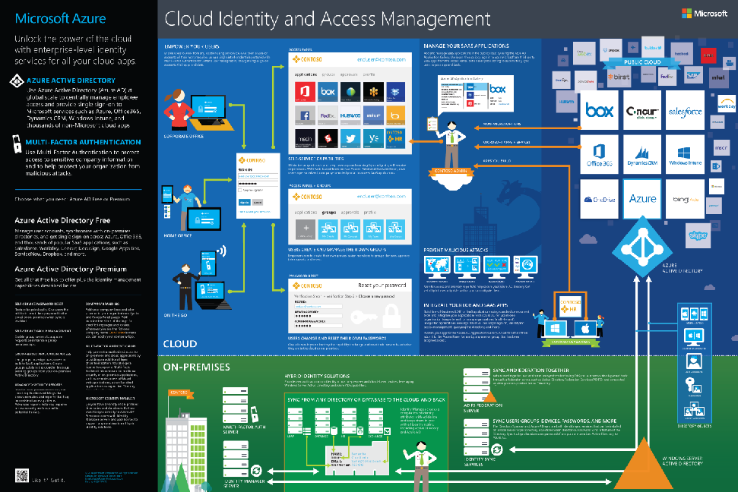
https://identity-test.datacomcc.com/Account/SignIn?ReturnUrl=/issue/wsfed?wa=wsignin1.0&wtrealm=http://dslfimad.dslfim.local/adfs/services/trust&wctx=00cacd9f-0aae-434a-b057-f1bfc0d5f1f3&wct=2014-08-12T20:31:58Z

Slide 89
For cloud authentication, Azure Active Directory has you covered

Slide 90
Resources
Azure blog - http://azure.microsoft.com/blog/
Ask Premier Field Engineering - http://blogs.technet.com/b/askpfeplat/
Active Directory Team blog - http://blogs.technet.com/b/ad/
Active Directory Passport plug-in - https://github.com/AzureAD/passport-azure-ad/
Microsoft Azure Active Directory Samples and Documentation - https://github.com/AzureADSamples/
Cloud Identity Infographic - http://azure.microsoft.com/en-us/documentation/infographics/cloud-identity-and-access/
Graph Explorer - https://graphexplorer.cloudapp.net/

Slide 91

Related Ignite NZ Sessions
1
O365 and Azure Active Directory Premium M315 - Wed 10:40 AM Ballroom 2
Find me later at…
Closing drinks Fri 3:00-4:30pm
2
Enabling AAD to Embrace Windows 10
M326 - Wed 3:10 PM New Zealand 1
3
Identity Management in O365
M362 - Thu 4:30 PM New Zealand 1

Slide 92





Resources
Microsoft Virtual Academy
TechNet & MSDN Flash
Free Online Learning
http://aka.ms/mva
Subscribe to our fortnightly newsletter
http://aka.ms/technetnz http://aka.ms/msdnnz
Sessions on Demand
http://aka.ms/ch9nz

Slide 93
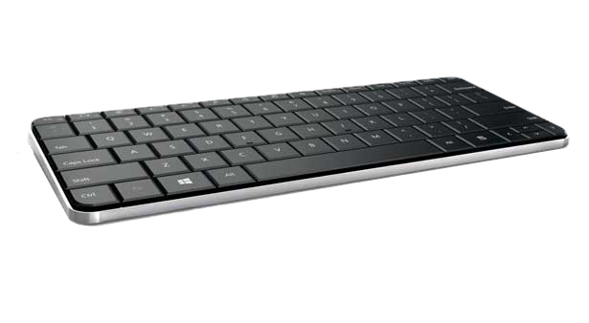
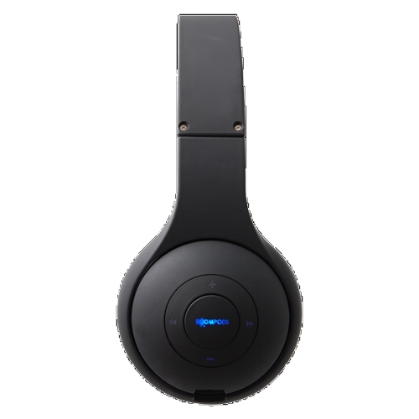
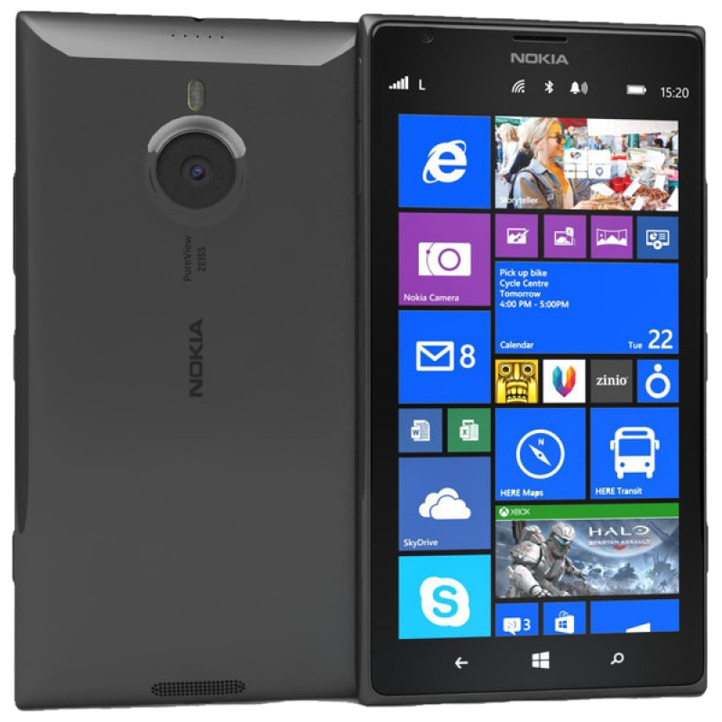
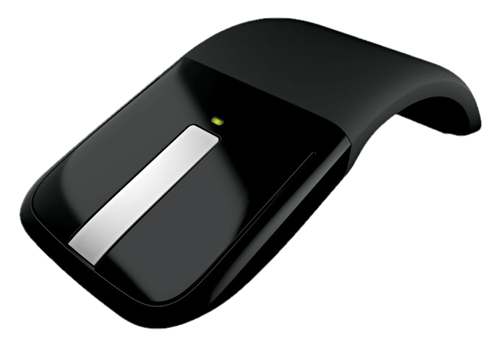

Complete your session evaluation now and be in to win!

